Slide 1
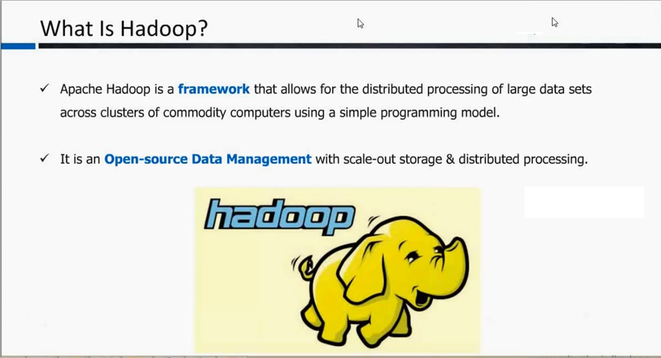

Slide 2
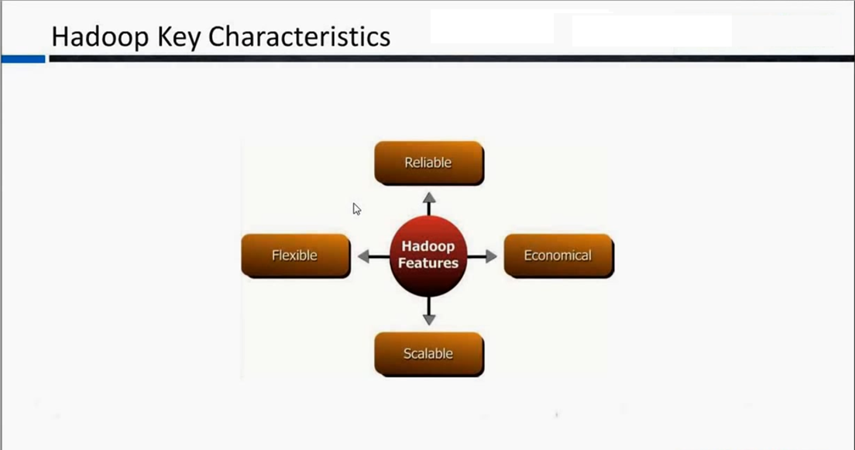

Slide 3
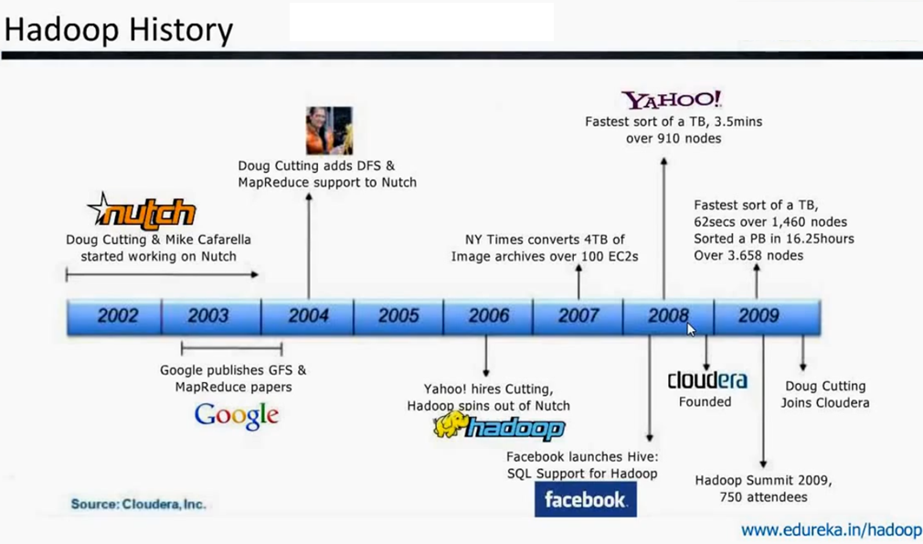

Slide 4
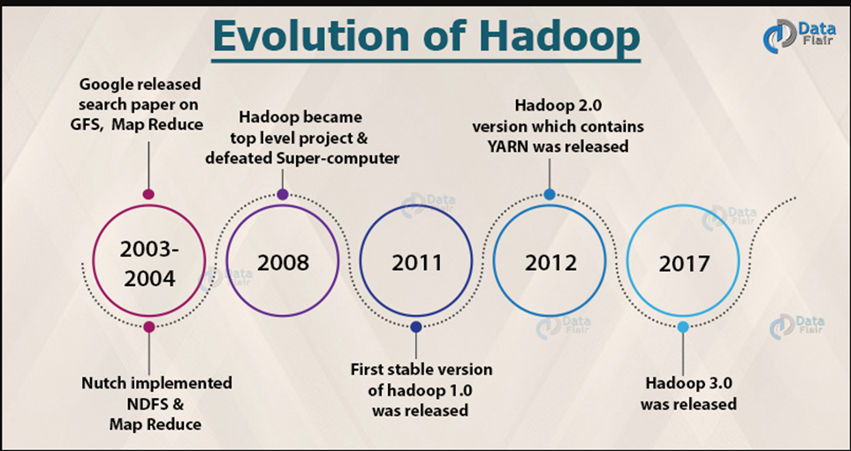

Slide 5
Hadoop Ecosystem
Overview: Apache Hadoop is an open source framework intended to make interaction with big data easier.
what is big data ?
Big data is a term given to the data sets which can’t be processed in an efficient manner with the help of traditional methodology such as RDBMS. Hadoop has made its place in the industries and companies that need to work on large data sets which are sensitive and needs efficient handling.
Hadoop is a framework that enables processing of large data sets which reside in the form of clusters. Being a framework, Hadoop is made up of several modules that are supported by a large ecosystem of technologies.

Slide 6
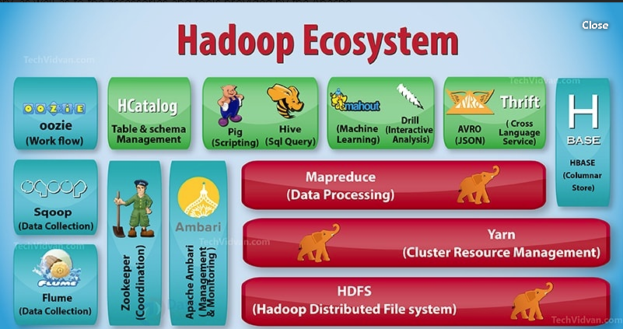

Slide 7
Hadoop is a framework that enables processing of large data sets which reside in the form of clusters.
Being a framework, Hadoop is made up of several modules that are supported by a large ecosystem of technologies.

Slide 8
Hadoop Ecosystem is a platform or a suite which provides various services to solve the big data problems. It includes Apache projects and various commercial tools and solutions.
There are four major elements of Hadoop i.e.
HDFS,
MapReduce,
YARN,
Hadoop Common.
Most of the tools or solutions are used to supplement or support these major elements.
All these tools work collectively to provide services such as absorption, analysis, storage and maintenance of data etc.

Slide 9
Components that collectively form a Hadoop ecosystem:
HDFS: Hadoop Distributed File System
YARN: Yet Another Resource Negotiator
MapReduce: Programming based Data Processing
Spark: In-Memory data processing
PIG, HIVE: Query based processing of data services
HBase: NoSQL Database
Mahout, Spark MLLib: Machine Learning algorithm libraries
Solar, Lucene: Searching and Indexing
Zookeeper: Managing cluster
Oozie: Job Scheduling

Slide 10
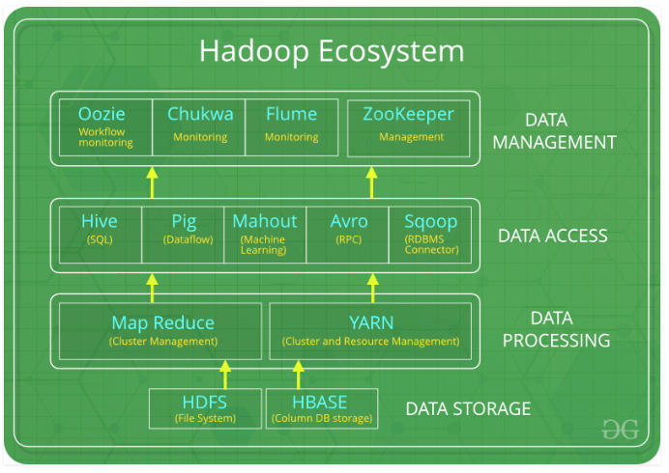

Slide 11
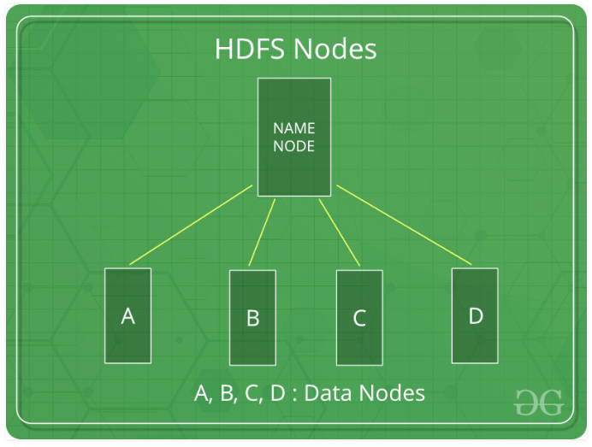
HDFS:
HDFS is the primary or major component of Hadoop ecosystem and is responsible for storing large data sets of structured or unstructured data across various nodes and thereby maintaining the metadata in the form of log files.
HDFS consists of two core components i.e.
Name node
Data Node
Name Node is the prime node which contains metadata (data about data) requiring comparatively fewer resources than the data nodes that stores the actual data.
HDFS maintains all the coordination between the clusters and hardware,
thus working at the heart of the system.

Slide 12
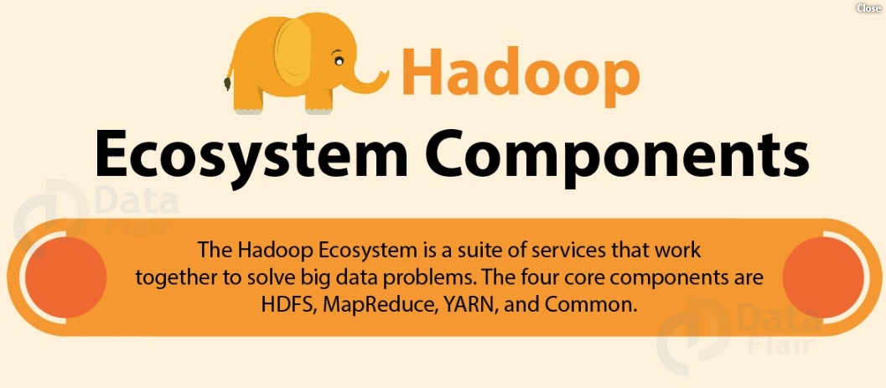

Slide 13
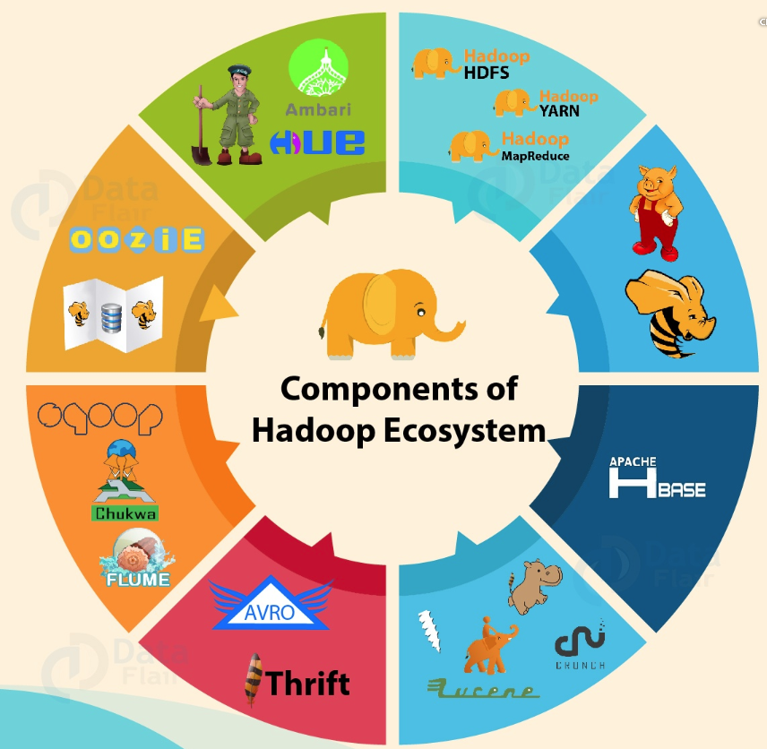

Slide 14
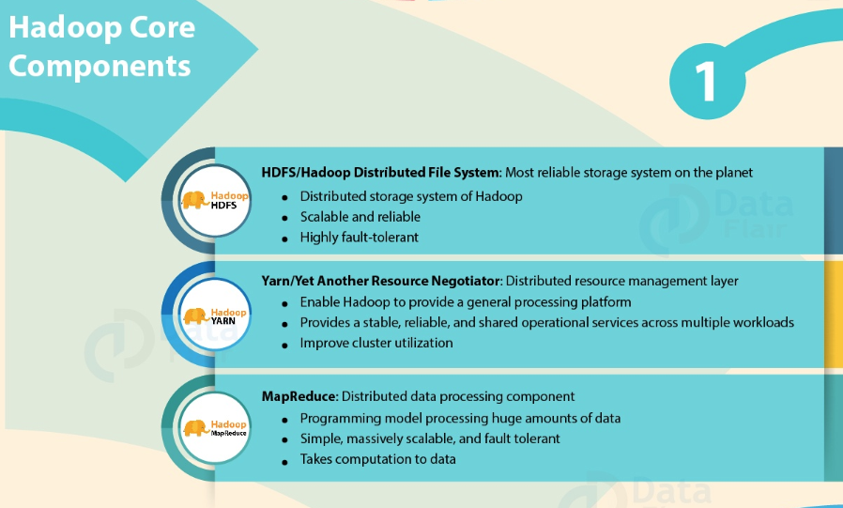

Slide 15
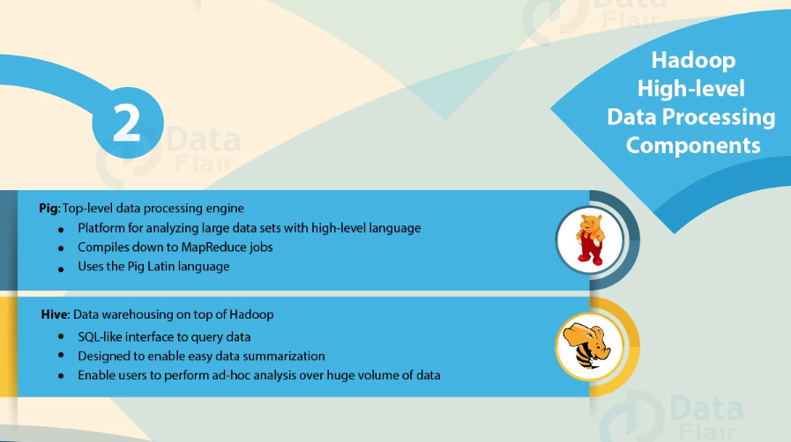

Slide 16
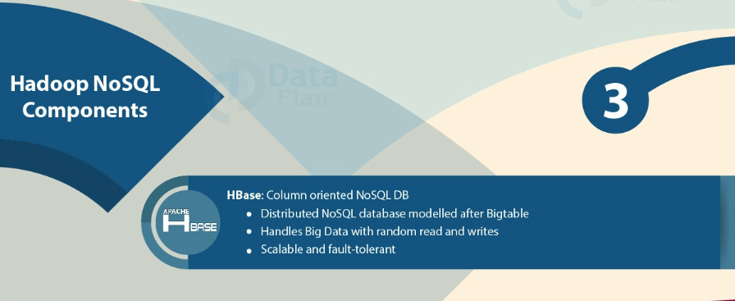

Slide 17
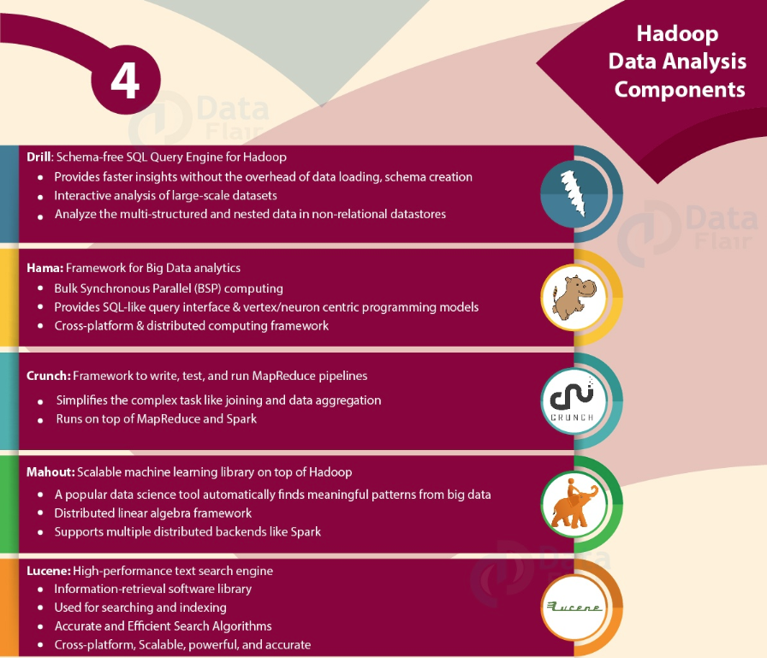

Slide 18
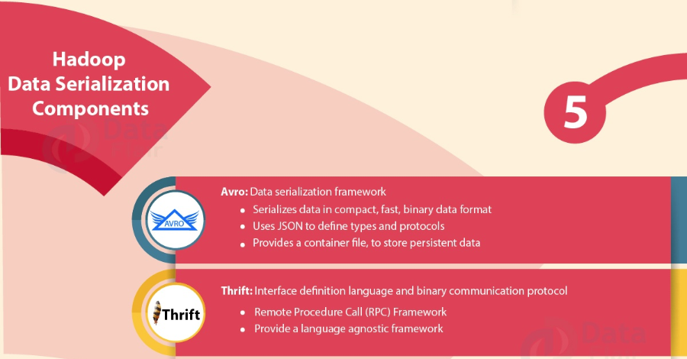

Slide 19
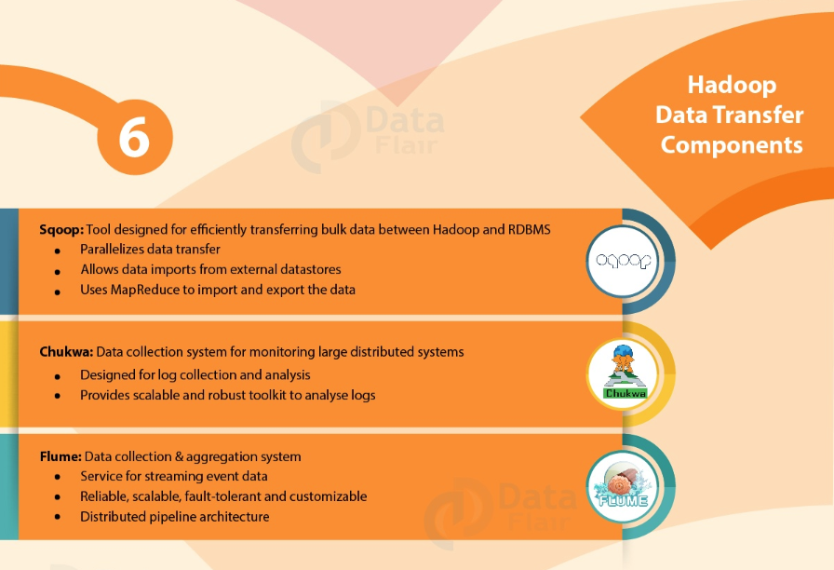

Slide 20
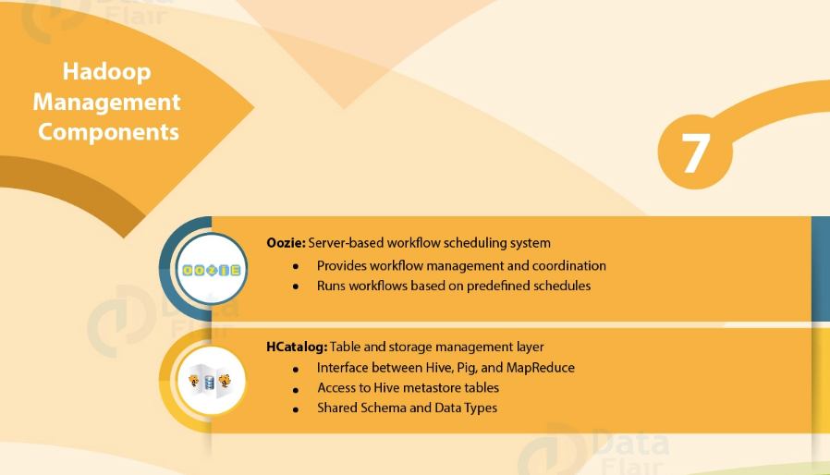

Slide 21
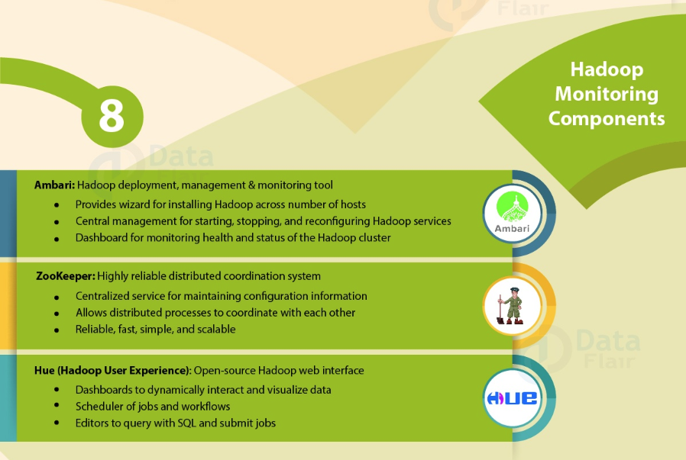

Slide 22
What is the difference between Hadoop vs Hadoop Ecosystem?
Hadoop is an open-source framework that allows to store and process big data in a distributed environment across clusters of computers using simple programming models. It is designed to scale up from single servers to thousands of machines, each offering local computation and storage.
The Hadoop ecosystem refers to the various components of the Apache Hadoop software library, as well as to the accessories and tools provided by the Apache Software Foundation for these types of software projects, and to the ways that they work together.

